Slide 1
STAT 2011 Group 1

Slide 2
Part 1

Slide 3
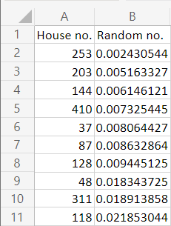
simple random sampling in excel
list out all house units
use random number function in excel
arrange in acsending order

Slide 4
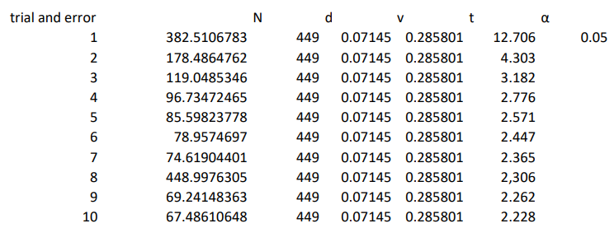
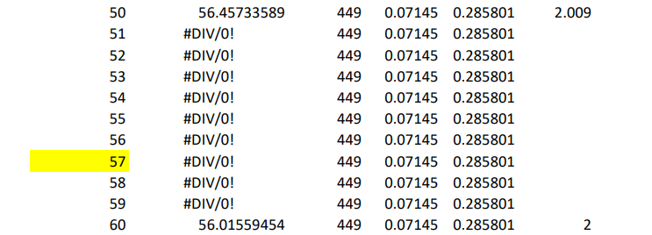
How to find the sample size?
n=1/(1/N+d^2/(v^2 t_(n-1,1-α/2)^2 ))
…
…
…
…
…

Slide 5
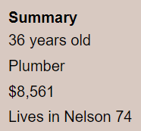

Survey
population can be asked by “How many people do you live with?”
the answer is including the person being asked
wealth can be asked by “How much money do you have?”
the answer is usually lower than the value given in the profile

Slide 6
Population
per unit = 2.403508772
Given population size = 1019
Estimate population size = 1079.175439
accurate

Slide 7
Total Wealth
per unit = 5309.77193
Given total wealth = 4515915
Estimate total wealth = 2384087.596
Not accurate

Slide 8
Part 2

Slide 9
Season of Providence

Slide 10
Division of Seasons by Diffrent Definitions
Meteorological Seasons → Divide 4 seasons by ranking temperature of each year
Dry Seasons / Rain Seasons → Divide 2 major seasons by ranking rainfall

Slide 11
Maximum Temperature Approach
(Meteorological Seasons)

Slide 12
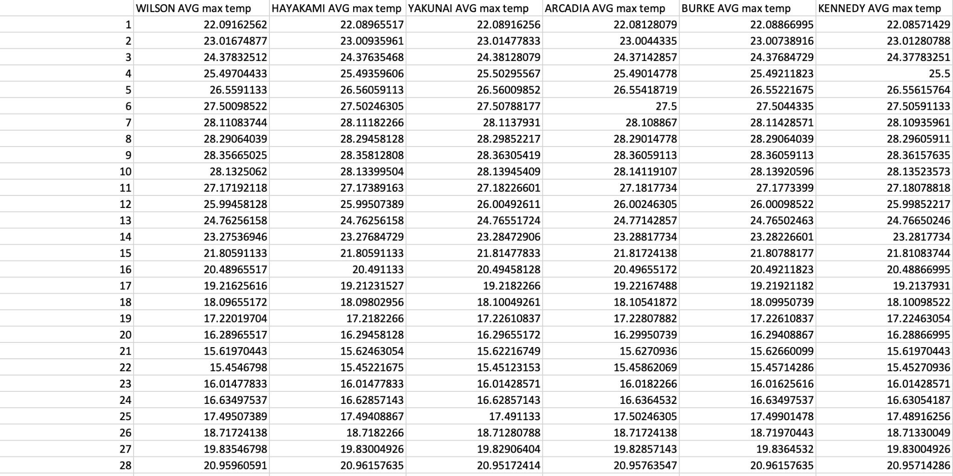
We obtained average temperature in each year (203 years) from 6 weather stations.

Slide 13
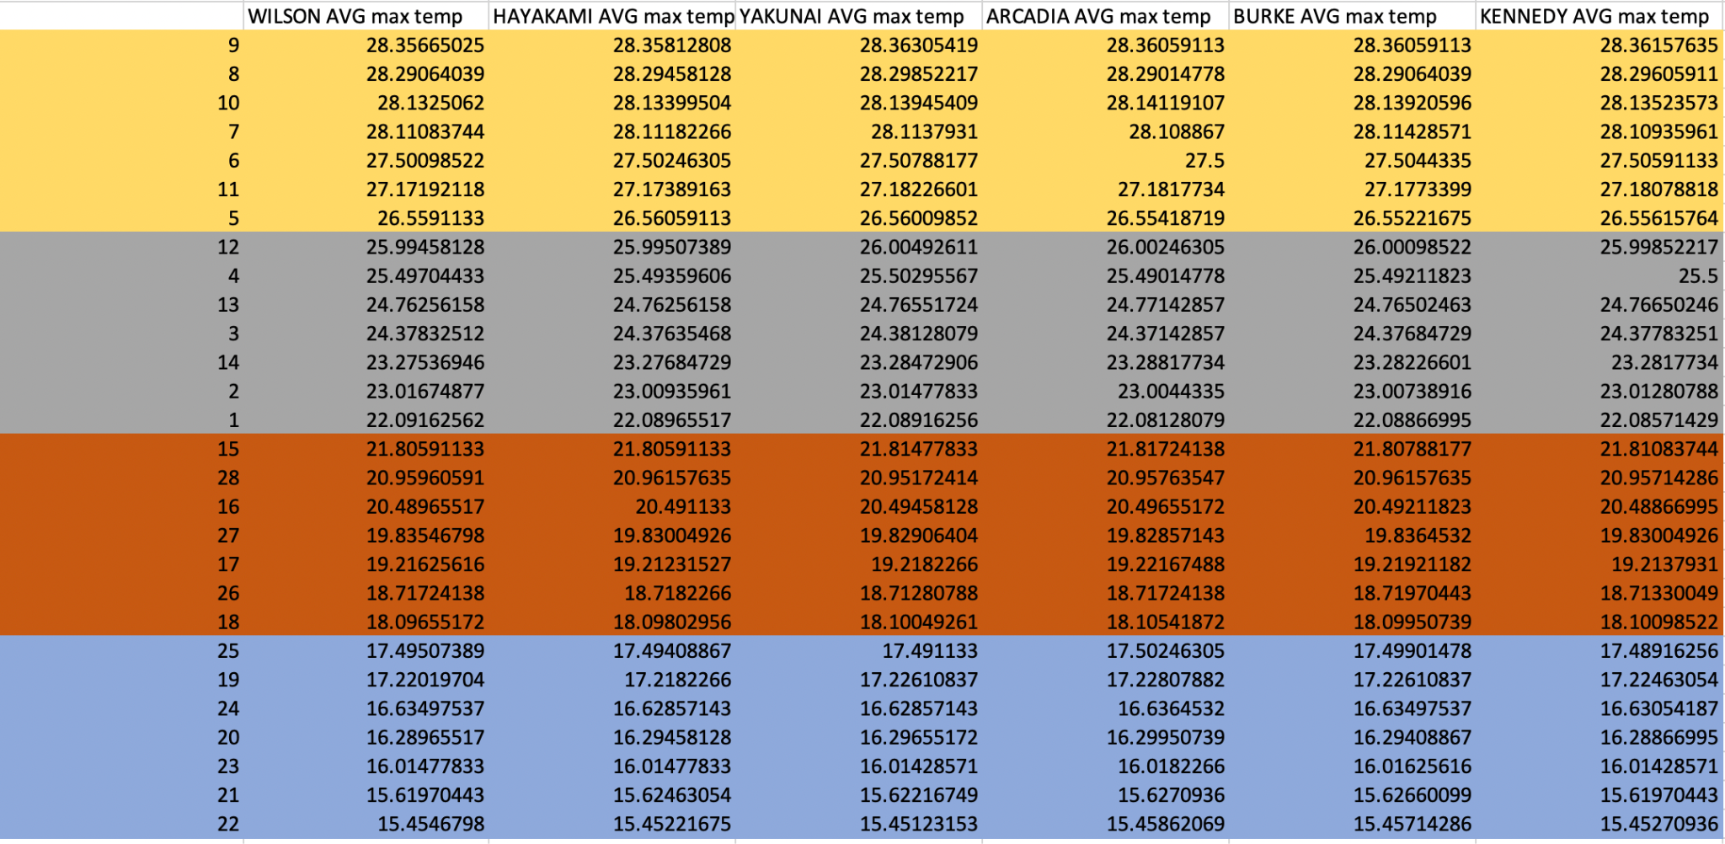
Sort the data from the maximum to the minimum.

Slide 14
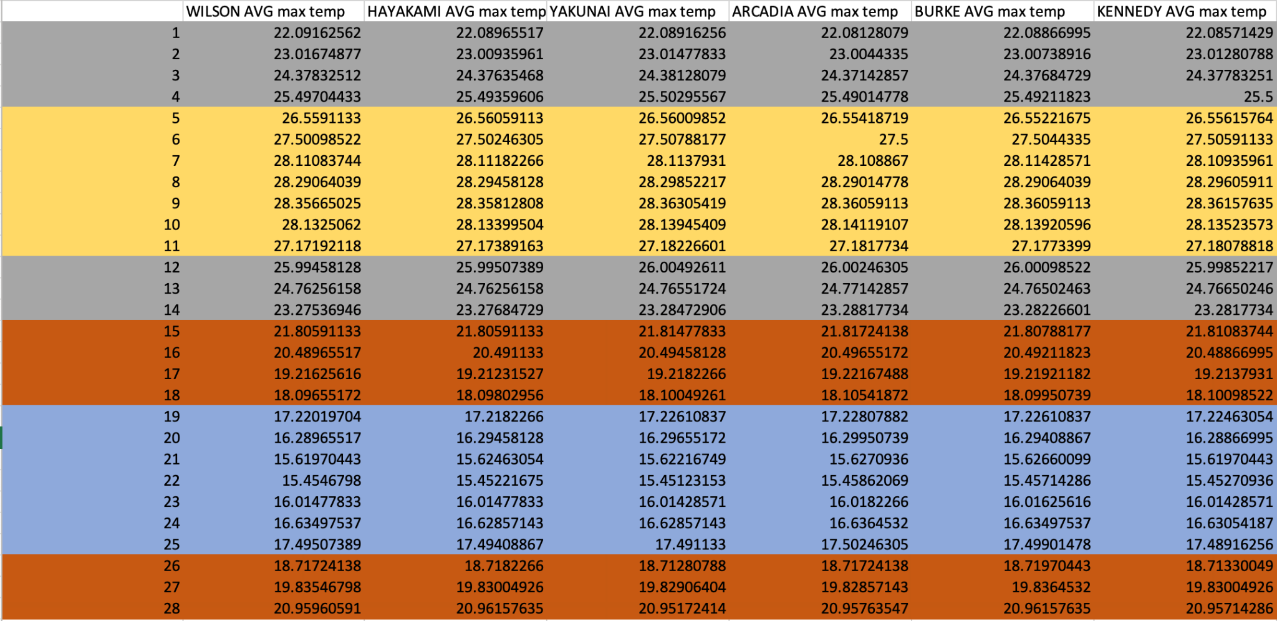
Meteorological Season will be sorted as:
Spring : day 26 - day 4
Summer: day 5 - day 11
Autumn : day 12 - day 18
Winter: day 19 - day 25

Slide 15
Rainfall Approach
(Dry Season/ Rainy Season)

Slide 16
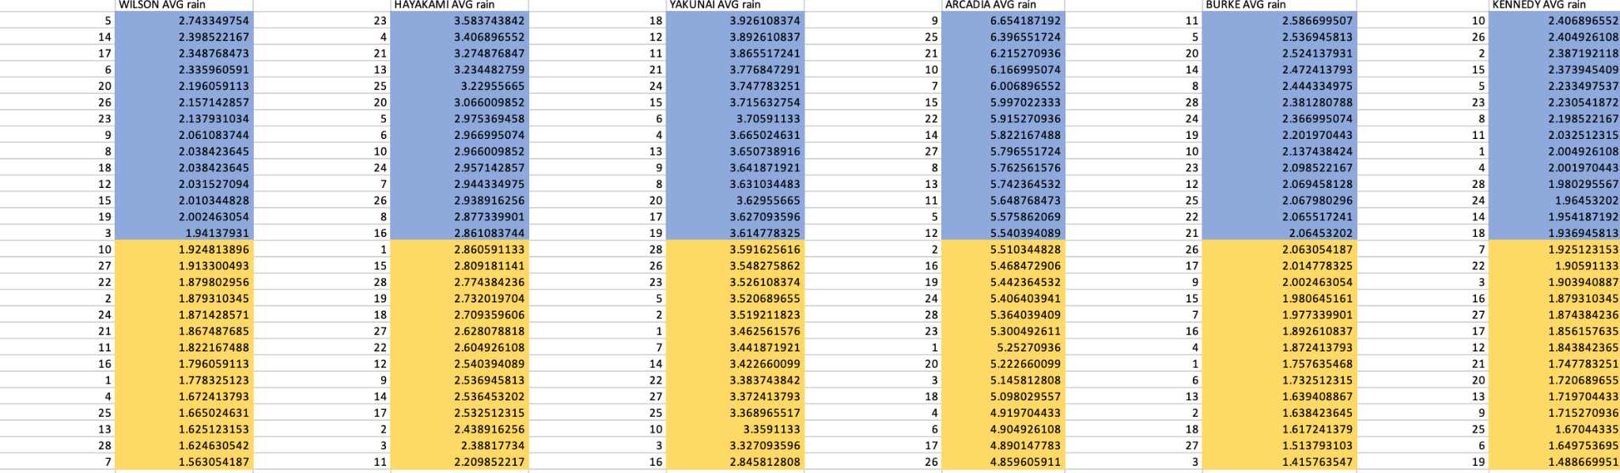
Sort the data from the maximum to the minimum and divide into 2 halves.

Slide 17
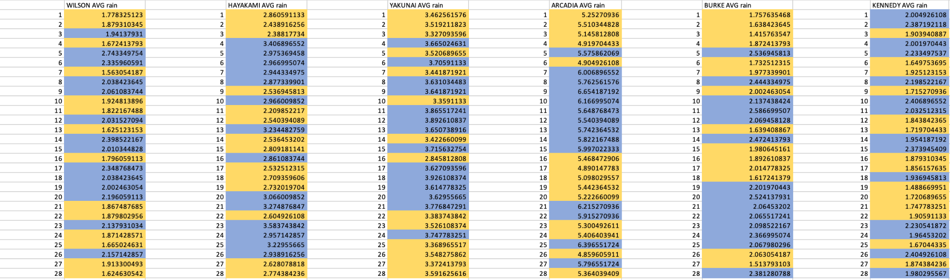
Arrange the data again in ascending order of day.
Results: Rainy and a dry season can not be divided since not all of them show a continuous trend.

Slide 18
Variation of Climate

Slide 19
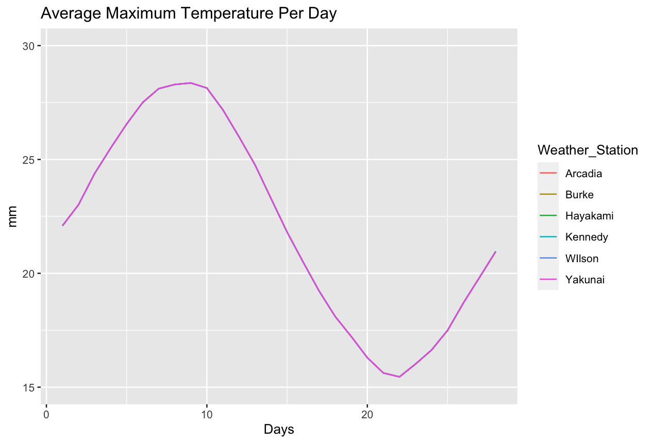
Day to Day Comparision

Slide 20
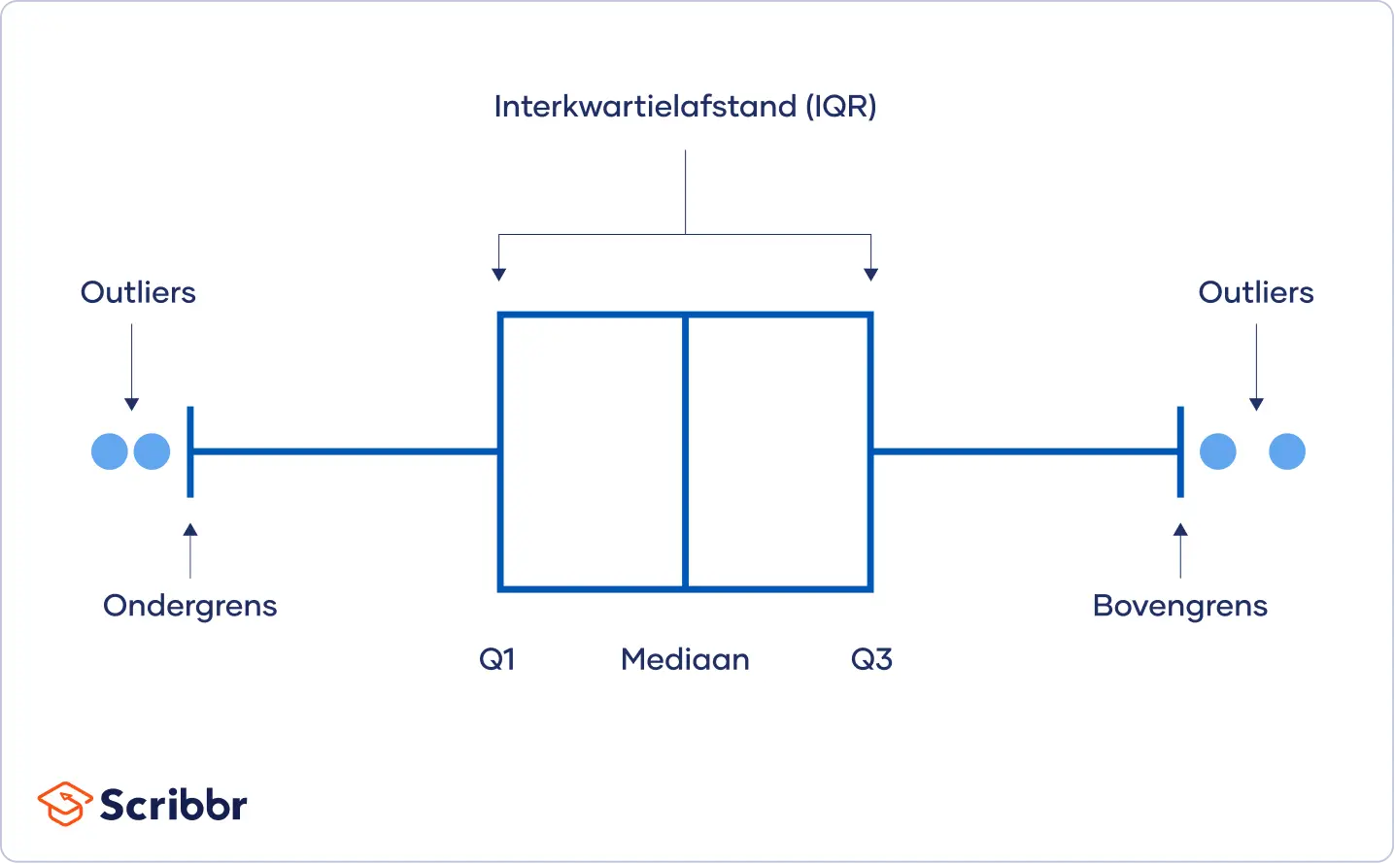
Boxplot
Can help to check: :
→ Range
→ Inter quartile range
→ Number of outliers

Slide 21
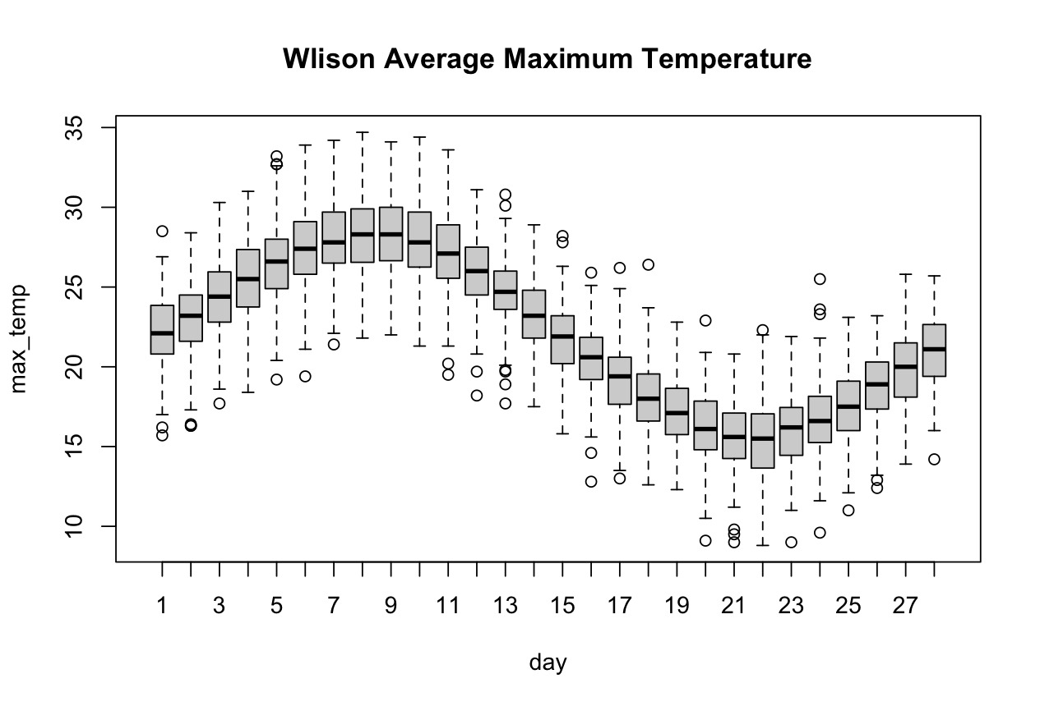
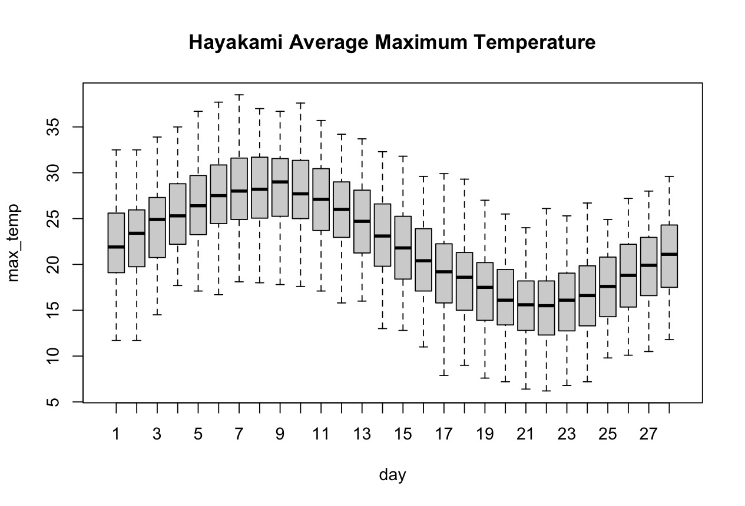
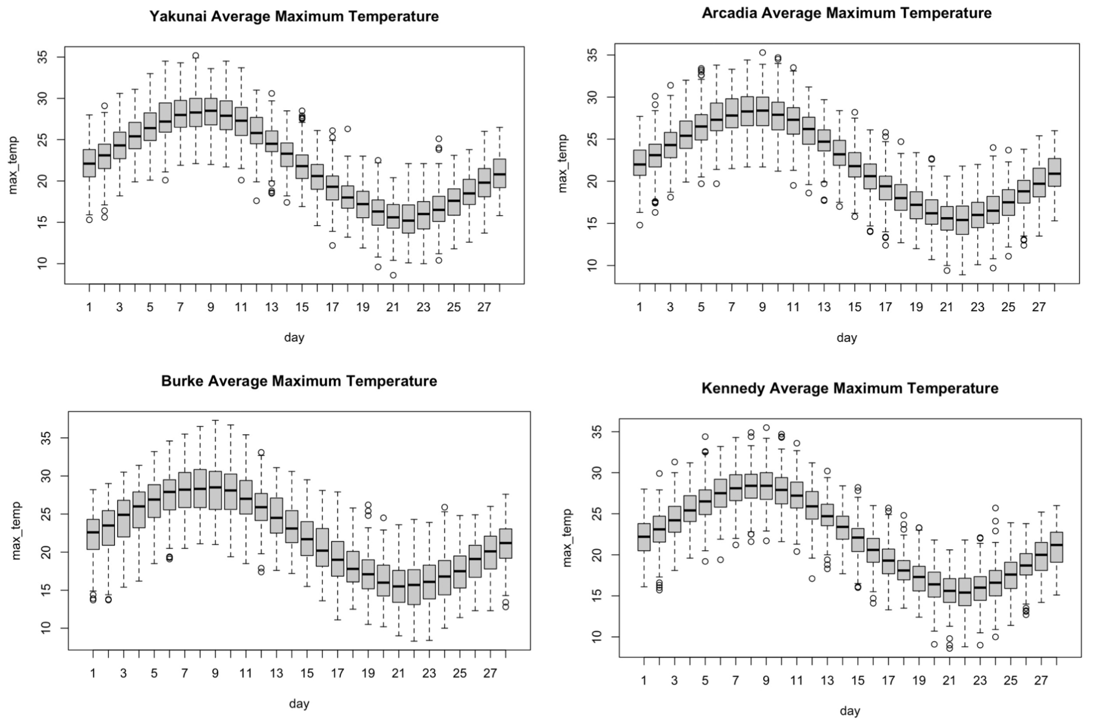
Boxplot on maximum temperature

Slide 22
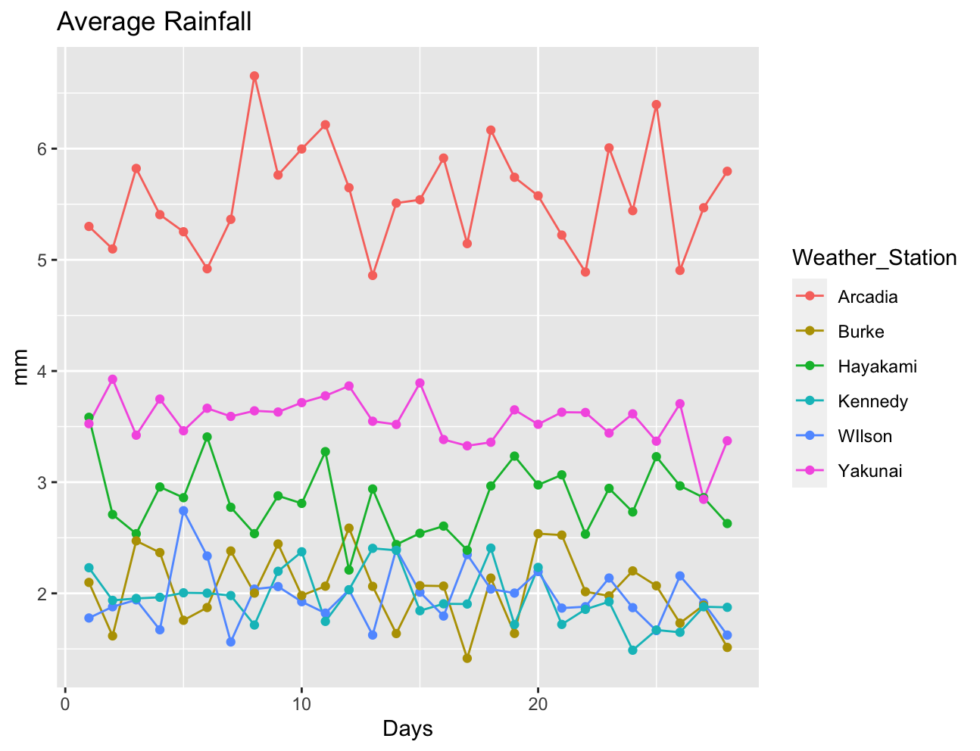
Day to Day Comparision

Slide 23
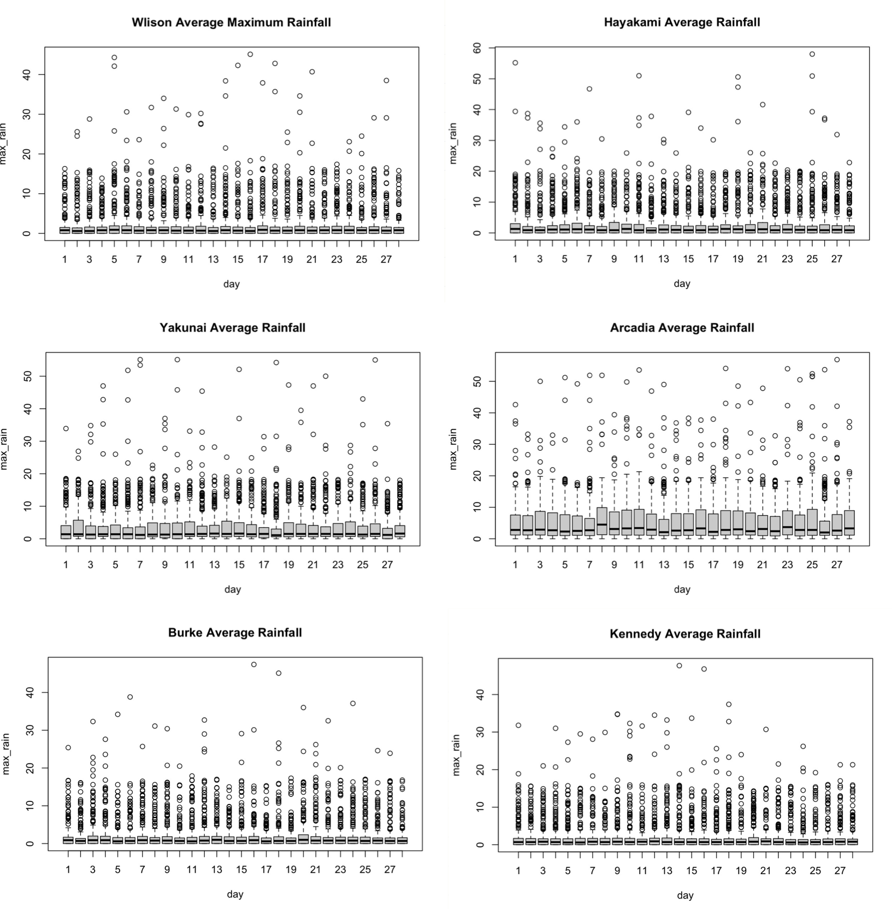
Boxplot on Rainfall

Slide 24
Conclusion
There is a huge variation of rainfall in different weather stations.
Variations on the central tendency especially for Arcadia and Yakunai in both average rainfall and central tendency analysis

Slide 25
Climate Change of Providence

Slide 26
Measuring Climate change by slope
1. Take averages of each year among different weather stations with respect to both maximum temperature and rainfall
2. Calculate the maximum temperature and rainfall of each year for the whole island
3. Find the slope for the best fitted line

Slide 27
Maximum Temperature
 | Slope
Wilson Weather Station | 0.0003430119
Hayakami Weather Station | 0.0003287488
Yakunai Weather Station | 0.0002998485
Arcadia Weather Station | 0.000352618
Burke Weather Station | 0.0005722313
Kennedy Weather Station | 0.0002648311

Slide 28
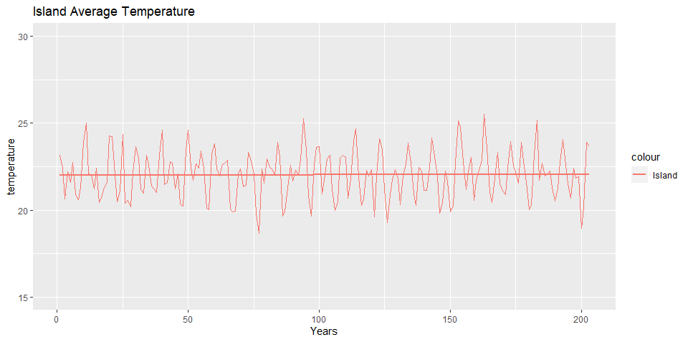
Maximum Temperature
 | Slope
Providence | 0.0003602149

Slide 29
Rainfall
 | Slope
Providence | 0.0001006172
Wilson Weather Station | -0.0002364893
Hayakami Weather Station | -0.0001875571
Yakunai Weather Station | -0.00114144
Arcadia Weather Station | 0.001665415
Burke Weather Station | 0.0005469327
Kennedy Weather Station | -0.00004315827

Slide 30
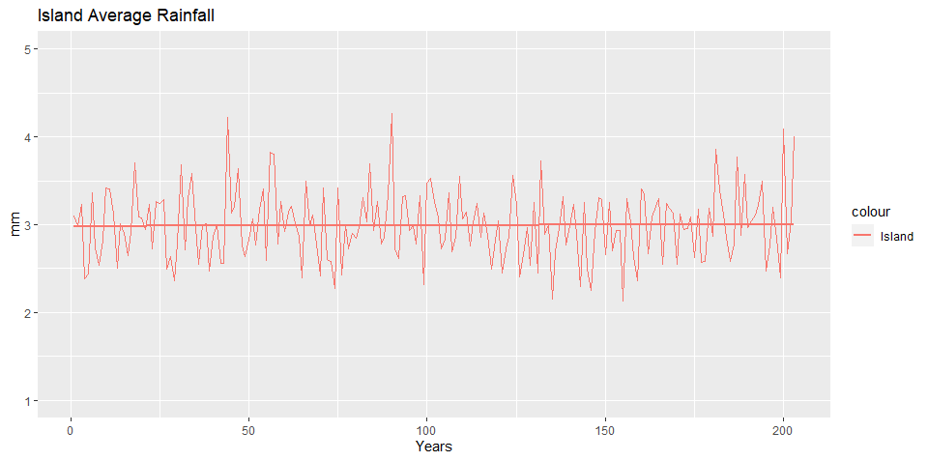

Slide 31
Conclusion
The Providence has very slight climate change.

Slide 32
Comparing Providence and the Real-World

Slide 33
Comparing Providence and
a real-world country/region
Draw connections between them that is most alike in climate by
-temperature
-rainfall
-geographic toplogy

Slide 34
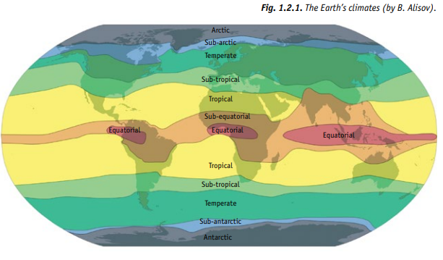
Dividing climate zones in real-world

Slide 35
The Providence
Largely dry due to the badlands comprising most of the islands
->Not polar zone (very low temperature)
->Not temperate zone (cold and wet)
->Only consider countries in the equatorial, sub-equatorial, tropical, and sub-tropical zones

Slide 36
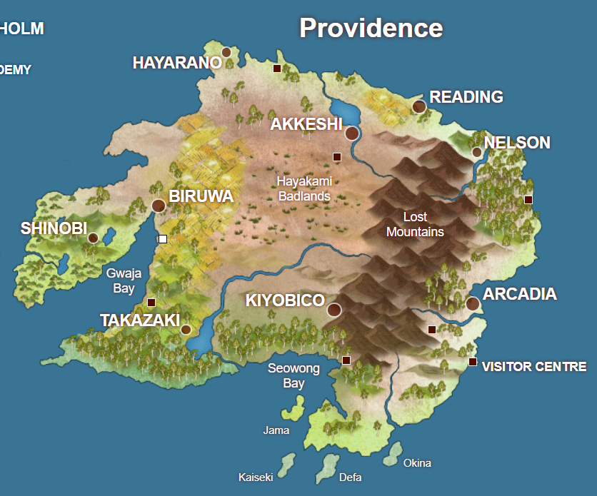
From the map:
The largest central part is dry and arid
The southern and eastern part is notably colder or wetter
->Climate varies largely due to location in the Providence island

Slide 37
Australia
Mainly in the tropical zone of the Earth
Different climates in Northern and Southern Australia

Slide 38
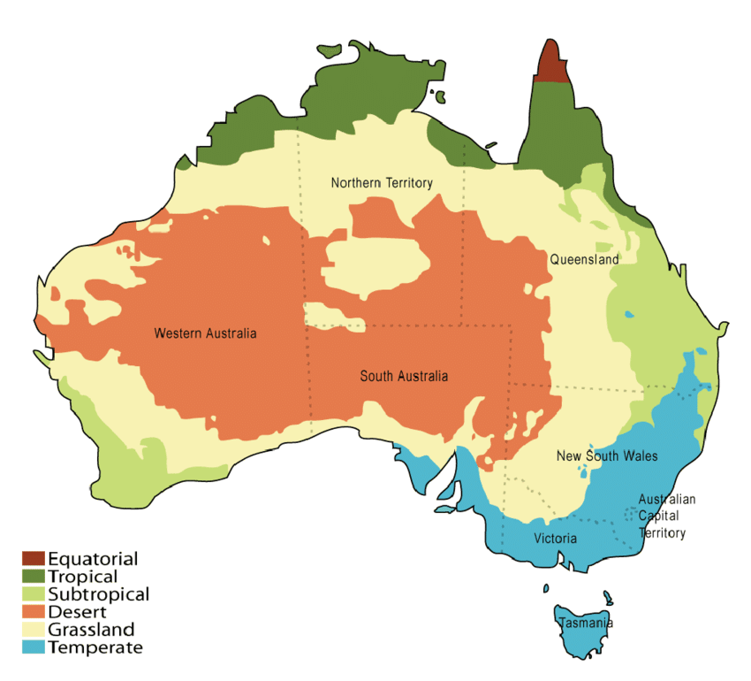
Similarities of Australia to the Providence

Slide 39
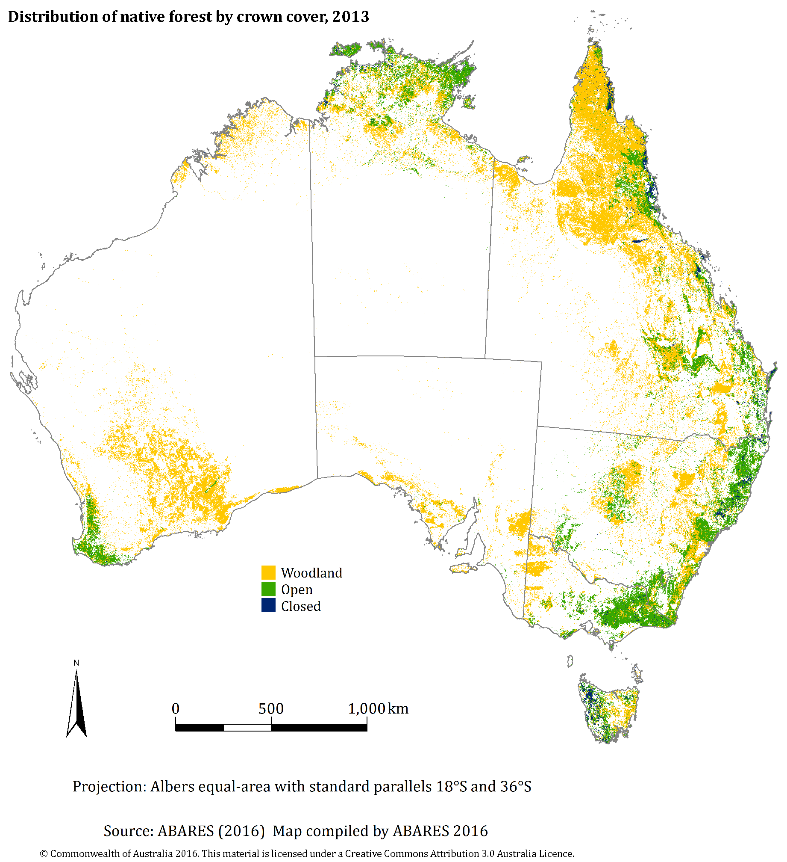
Similarities of Australia to the Providence

Slide 40
Conclusion
The Providence is most similar to Australia,in terms of climate

